Slide 1

The Great Pizza Analytics Challenge
A mini-project challenge

Slide 2
About the data analyst
Highly proficient in Microsoft Excel, SQL, and Power BI, with excellent organizational skills and a strong focus on driving data-informed decision-making.
Jyoti Kumar

Slide 3
Project overview
IDC Pizza is an Indian pizza restaurant chain. Who is planning to optimize marketing strategies, improve customer satisfaction, and drive revenue growth by identifying trends, patterns, and actionable insights from customer data.

Slide 4
Project Goals
Database creation and table design.
Filtering the dataset.
Aggregations
Joins
Data Cleaning

Slide 5
Process
The project is divided into three phases, each with a different difficulty level.
Phase 1: Foundation and Inspection
Understanding your dataset is the crucial first step in analysis, as it provides the foundation
for accurate and insightful findings.
The second step was to validate the data for accuracy, completeness, and consistency. It helps
prevent errors, improve data quality, and ensure compliance with ethical and legal requirements.
The last step in this phase was data cleaning, where we dealt with NULLS and replaced
missing values.

Slide 6
Process
Phase 2: Filtering
In this phase, we were focused on removing irrelevant, noisy parts of the dataset using different
filtering methods.
Here, we used time-based, criteria-based, text, and numeric filtering techniques.
Filtering data provides several advantages, like improved efficiency by reducing computational
load, saving time and resources, and ensuring sensitive or irrelevant data is excluded which in turn
enhance privacy and compliance.

Slide 7
Process
Phase 3: Aggregating and Analyzing Sales Performance
Aggregated data provides a holistic view of performance metrics and key indicators.
In this phase, we got the opportunity to explore the most common SQL aggregation functions,
like COUNT(), SUM(), AVG(), we paired these functions with the GROUP BY clause to aggregate
data based on a specific category.
We also used different types of JOINS effectively to ensure data is retrieved in a structured,
meaningful way, supporting complex queries and reporting needs.
In the final phase of the project, we documented our queries and submitted the result set.

Slide 8
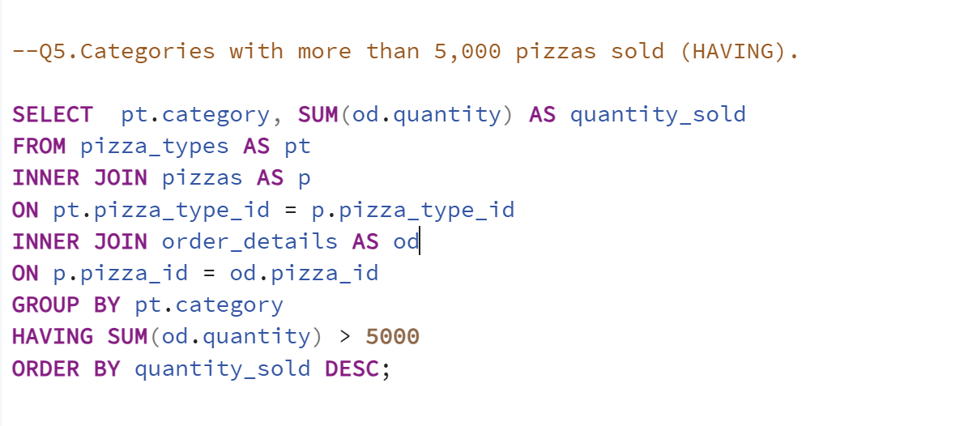
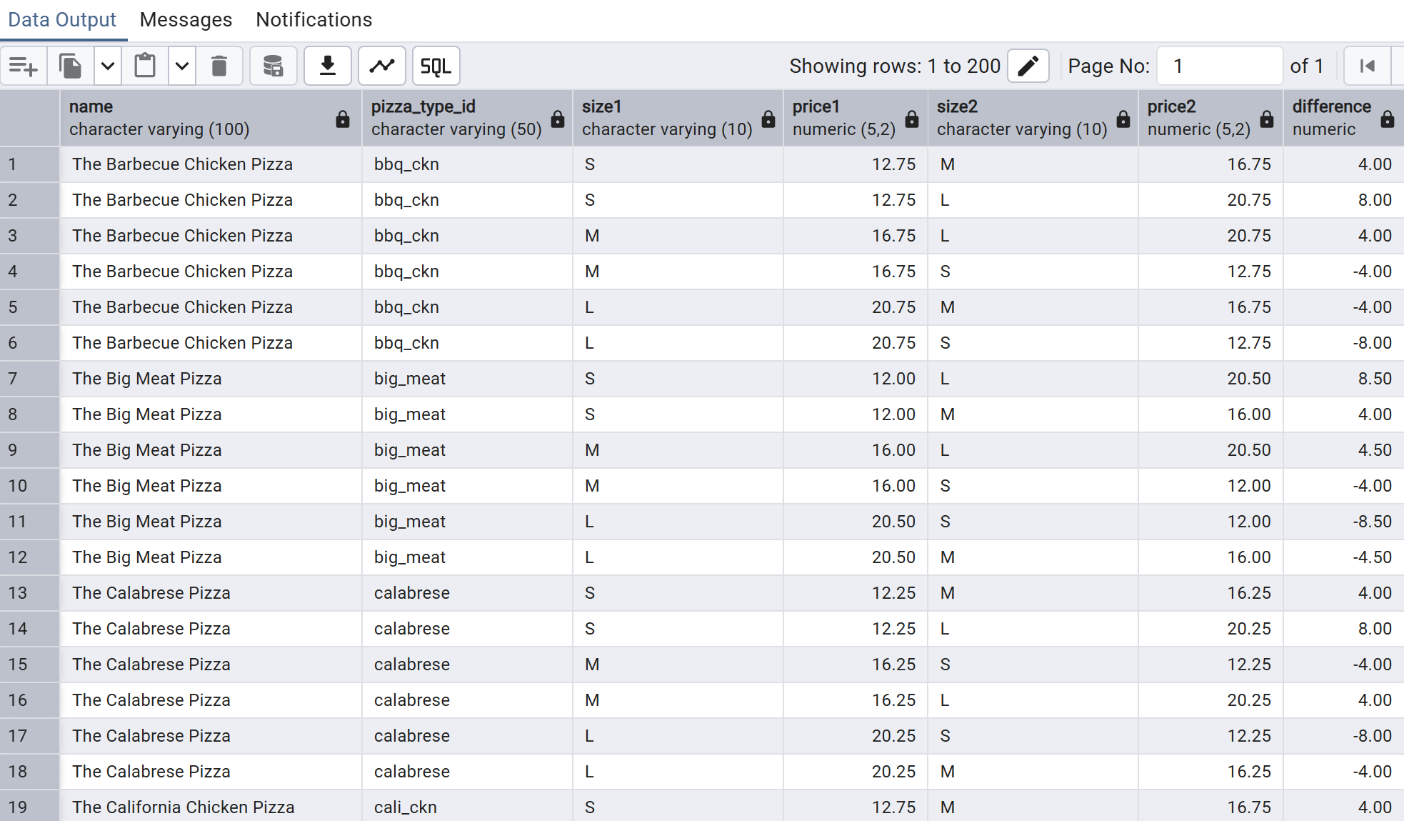
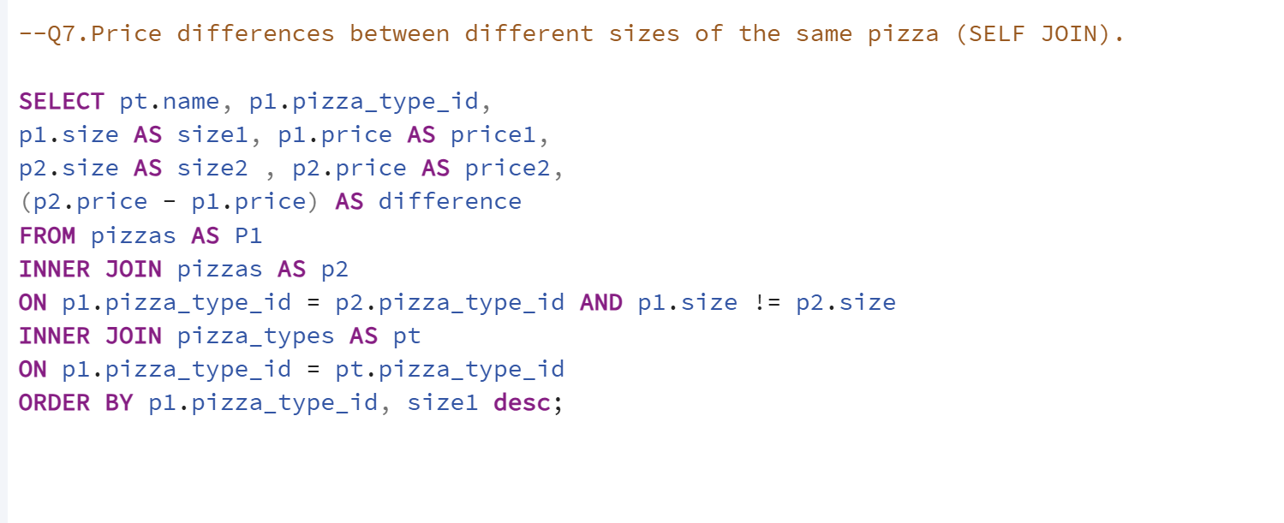
Glimpse of our project

Slide 9

Thank You, Indian Data Club, DPD Zero
&
LinkedIn Friends for the continuous support

